Slide 1
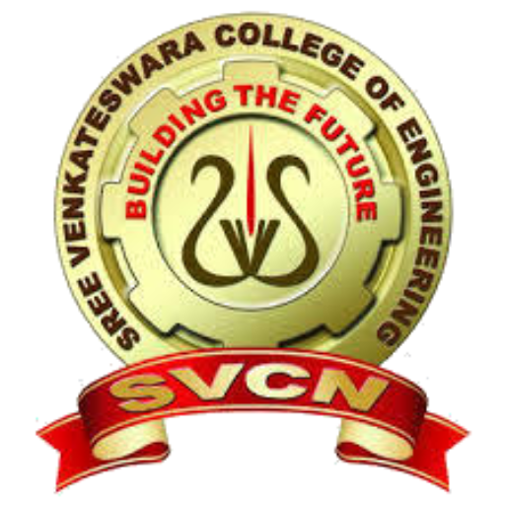

SREE VENKATESWARA COLLEGE OF ENGINEERING (Accredited with NAAC “A”, UGC 2(f) Recognized & ISO 9001::2015 Certified Approved by AICTE, New Delhi and Affiliated to JNTUA – Anantapuramu) North Rajupalem, Kodavaluru (V&M), SPSR Nellore.
HAND GESTURE RECOGNITION AND VOICE CONVERSION FOR DEAF AND DUMB

Slide 2
PROBLEM STATEMENT
To communicate with the wider public, deaf and dumb people rely significantly on sign language. Those persons find it challenging to express their message to regular people. Due to a lack of communication, deaf and dumb people are unable to transmit and express their feelings. Dumb and deaf persons use sign language to communicate with those who are not deaf or dumb. Those individuals find it extremely difficult to communicate their message to the general public. They are uneasy about taking on such a massive task. Dumb and deaf individuals believe they are unable to communicate because of a lack of communication, and as a result, they are unable to convey their emotions. Because most individuals aren't trained in sign language, communicating their message in an emergency is extremely challenging.
As a result, the solution to this challenge is to transform hand movements into human hearing voice and text.

Slide 3
abstract
Individuals primarily communicate with one another. Dumb and deaf people use sign language to communicate with others. These individuals have difficulty communicating their message to ordinary people. Deaf and dumb people believe they are unable to communicate because of a lack of communication skills, and as a result, they are unable to express their emotions. Because most individuals aren't educated in sign language, communicating in an emergency can be extremely challenging. As a consequence, the challenge may be solved by converting hand gestures into human-hearing sounds and text. Vision and non-vision approaches are two of the most commonly used methods for detecting hand movements or gestures. In a vision-based approach, a camera will be used for gesture detection, whereas sensors will be employed in a non-vision-based technique. In this study, a vision-based technique was used. This device detects and locates hand motions in order to keep a communication channel open with others. Using CONVOLUTIONAL NEURAL NETWORKS, this research develops a gesture recognition system. This study looks into the advantages and disadvantages of hand motion recognition.

Slide 4
Existing system
The existing system for the project is Support Vector Machine (SVM). The data is divided into two or more categories using the Classifier model which is a supervised learning method based on kernels. For binary classification, SVM was developed and utilized. Support vector machines' training step involves building a model, mapping each class's decision boundaries, and locating the hyperplane that divides the various classes. By enhancing the hyperplane margin, the distance between the classes may be increased while maintaining classification accuracy. The implementation's core is libsvm. The fit time complexity is more than quadratic with the number of samples, making it difficult to scale to datasets with more than a few tens of thousands of samples. The management of the multiclass support is done using the one-vs-one approach.

Slide 5
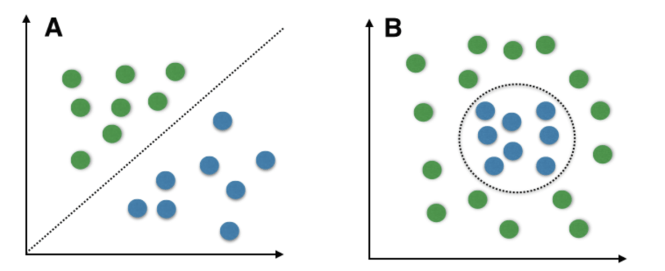
architecture of Existing system

Slide 6
Disadvantages of Existing system
SVM is less adaptable. SVM requires handcrafted feature extraction which can be time-consuming and challenging.
SVM has less interactive user interface.
SVM has lower recognition capability.
SVM is less efficient and less accurate.

Slide 7
proposed system
The system we propose for the project is Convolutional Neural Networks (CNN). The recommended model is Sequential model because this deep learning model is founded on a sequence of layers. The model passes information from the input layer to the hidden layer and finally to the output layer. Convolution's main goal is to find the features in our image using a feature detector and arrange them in a feature map in order to retain the spatial link between pixels.

Slide 8
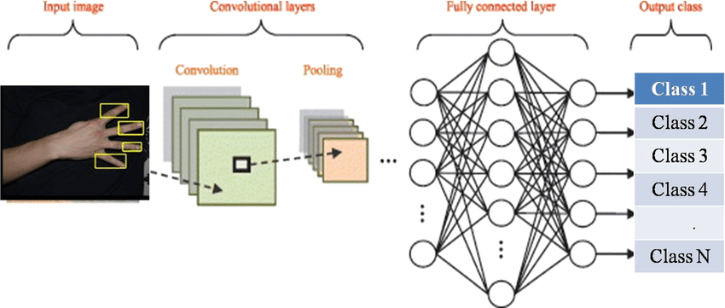
ARCHITECTURE of proposed system

Slide 9
Advantages of proposed system
CNN is more adaptable. CNN can learn more complex features directly from raw data, which can save time and effort in feature extraction.
CNN has more user-friendly interface compared to SVM. It will be designed to be easy to use for individuals with no technical expertise and it will provide clear feedback on the recognized gestures.
CNN has higher recognition capability than SVM. CNN is a deep learning model that can automatically learn and extract features from data, which can lead to better performance in complex tasks like hand gesture recognition.
CNN is more accurate and more efficient when compared to SVM.

Slide 10
Hardware requirements
The following are the hardware requirements needed to develop the project:
Hardware Parameter | Specification
Processor | Intel Core i3 (minimum)
Webcam | 720 pixel (minimum)
RAM | 2 GB (minimum)
Hard disk | 256 GB (minimum)
Keyboard | Standard Windows Keyboard
Mouse | Standard Mouse
Monitor | SVGA

Slide 11
software requirements
The following are the software requirements needed to develop the project:
Software Parameter | Specification
Operating System | Windows 7 or 8 (minimum)
Programming Language | Python

Slide 12
Future scope
Here are some of the potential areas where this technology could be applied:
Communication for the Deaf and Dumb: One of the primary applications of Hand Gesture Recognition and Voice Conversion technology is to provide a communication platform for the deaf and dumb. With this technology, deaf and dumb individuals can communicate with each other using sign language and converted voice, enabling them to interact with others more effectively.
Augmented Reality: Hand Gesture Recognition technology can be integrated with Augmented Reality (AR) to create a more immersive and interactive experience for users. This technology can be used in gaming, education, and training industries to create a more realistic and hands-on experience for users.

Slide 13
Future scope
Here are some of the potential areas where this technology could be applied:
Healthcare: Hand Gesture Recognition and Voice Conversion technology can be used in the healthcare industry to help doctors and nurses communicate with the patients who are deaf and dumb. This technology can also be used in surgical procedures where voice commands are used to control the medical equipment.
Automotive Industry: Hand Gesture Recognition technology can be used in the automotive industry to enhance the user experience by allowing drivers to control various features of their vehicle using hand gestures.

Slide 14
Future scope
Here are some of the potential areas where this technology could be applied:
Robotics: Hand Gesture Recognition and Voice Conversion technology can be used in robotics to provide more natural and intuitive control mechanisms for robots. This technology can be used to develop robots that can interact with humans more effectively.
Smart Homes: Hand Gesture Recognition technology can be used in smart homes to provide more natural and intuitive control mechanisms for home appliances and devices. This technology can be used to develop smart homes that can be controlled using hand gestures and converted voice.

Slide 15
THANKYOU

